Slide 1
Data Structures and Algorithms Design
Febin.A.Vahab
2019-20

Slide 2
SESSION 15 -PLAN
Sessions(#) | List of Topic Title | Text/Ref Book/external resource
15 | Range Queries, Performance k-d Trees, Representation, Region based and point based queries, Performance | T1: 3.1 T1: 12.3.2
Page <number>

Slide 3
Binary Search Tree
A binary search tree is a binary tree storing keys (or key-element pairs) at its internal nodes and satisfying the following property
    Let u, v, and w be three nodes such that u is in the left subtree of v and w is in the right subtree of v. We have key(u) ≤ key(v) ≤ key(w)
Page <number>

Slide 4
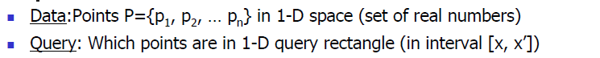

Range query
A range query q(A,i,j) on an array A=[a1,a2,a3,..,an] of n elements of some set S, denoted A[1,n], takes two indices 1<=i<=j<=n ,a function f defined over arrays of elements of S and outputs f(A[i,j])=f(ai,……,aj)
Application. Database queries.
Page <number>

Slide 5
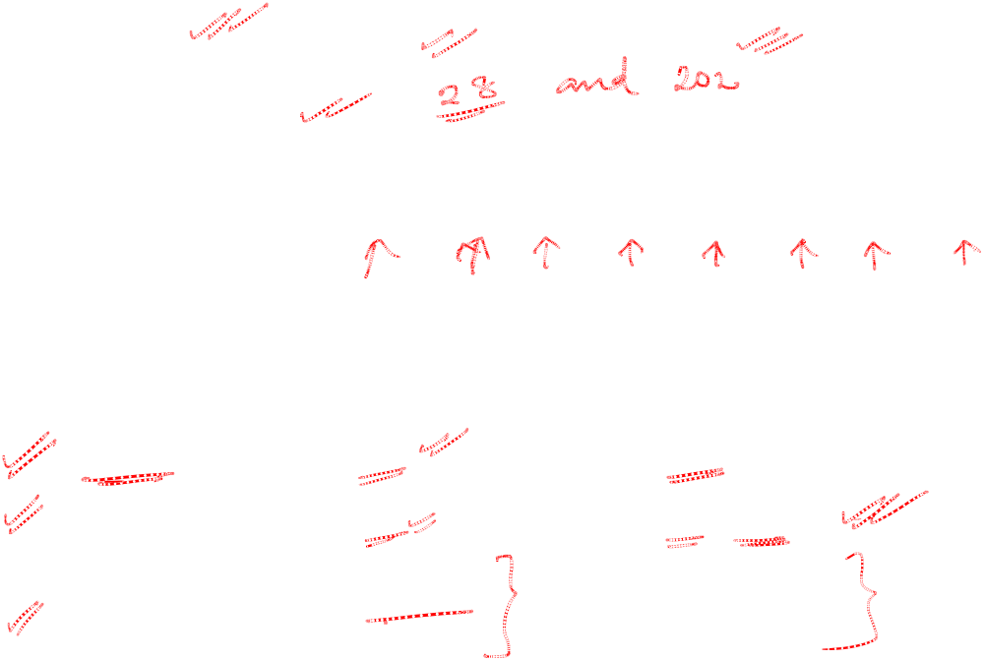
Range query
Range: [x, x’]
A=
3 | 9 | 27 | 28 | 29 | 98 | 141 | 187 | 200 | 201 | 202 | 999
Data Structure | Insert | Range search
Unsorted array | 1 | N
Sorted array | N | K+log N*
Goal | Log N | K+log N
*Search for x and x’ in A by Binary search takes O(log n) time,Output all points between them ,takes O(k) time, Total : O(k+logn)
Page <number>

Slide 6
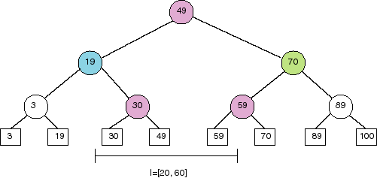
Range query
Data Structure :BST
  Search using binary search property.
  Some subtrees are eliminated during search.
Page <number>

Slide 7
BST with data stored in leaves
Retrieving data in [x, x’]
  Perform binary search twice, once using x and the other using x’
  Suppose binary search ends at leaves l and l’
  The points in [x, x’] are the ones stored between l and l’ plus, possibly, the points stored in l and l’
Page <number>

Slide 8

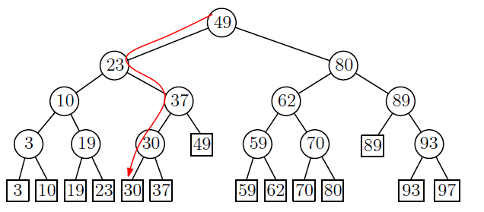
BST with data stored in leaves
Example: retrieve all points in [25, 90]
  The search path for 25 is:
Page <number>

Slide 9
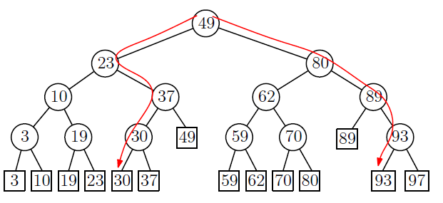
BST with data stored in leaves
  Example: The search for 90 is:
Page <number>

Slide 10
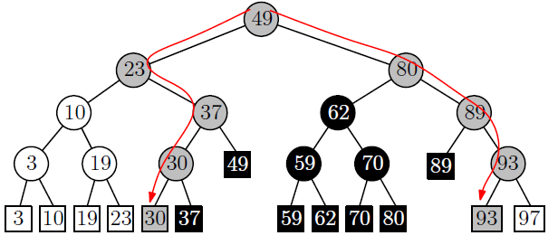
BST with data stored in leaves
Examine the leaves in the sub-trees between the two traversing paths from the root.
Split node
Retrieve all points in [25, 90]
Page <number>

Slide 11

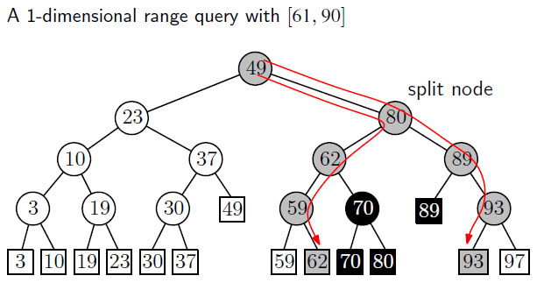
1Dimensional Range Search – Another Example
Page <number>

Slide 12
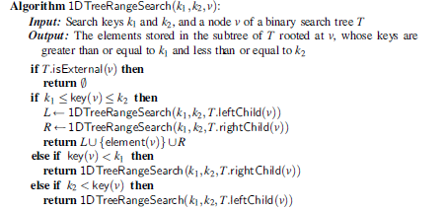

Algorithm
lDTreeRangeSearch (k1 , k2 , v) :
Page <number>

Slide 13
Range Search
How do we find the leaves of interest?
Find split node (i.e., node where the paths to x and x’ split).
Left turn: report leaves in right subtrees
Right turn: report leaves in left substrees
Page <number>

Slide 14
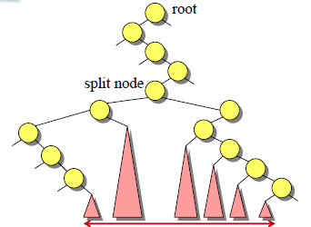
Range Search
Page <number>

Slide 15
Range Search
O(logn + k) time where k is the number of items reported.
Operations insertltem and removeElement each take O(log n) time
Page <number>

Slide 16
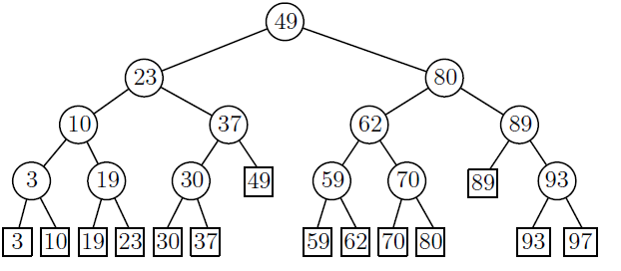
Range Search
Speed-up search by keeping the leaves in sorted order using a linked-list
Page <number>

